Slide 1



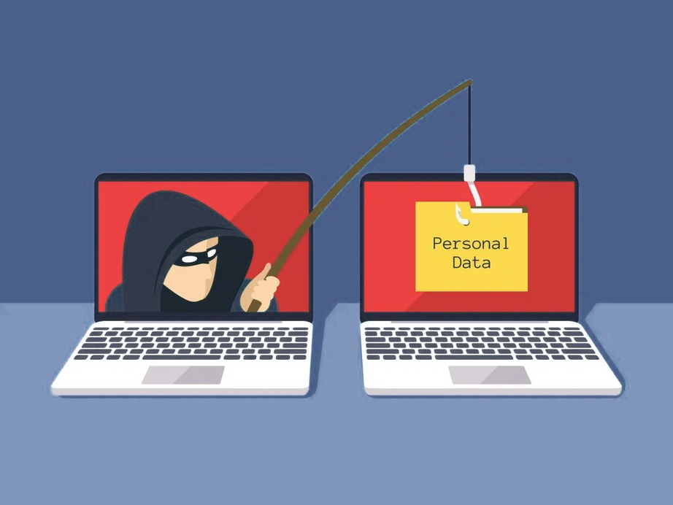

Phishing Awareness
Protect Yourself from Phishing Attacks
Presented by:
Mohsina Rubaab

Slide 2

What is Phishing?
Definition: Phishing is a type of cyber attack where attackers trick you into revealing sensitive information like passwords, credit card numbers, or personal details
Importance: Phishing is one of the most common ways attackers breach accounts and steal data.
Objective: Learn to identify, avoid, and report phishing attempts.

Slide 3
Types of Phishing Attacks
Email Phishing
Spear Phishing
Fake emails that look legitimate, designed to steal personal info or login credentials.
Targeted attacks on specific individuals using personalized information to appear credible.
Smishing
Vishing
Phishing via SMS messages that trick users into clicking links or sharing sensitive info.
Phishing over the phone where attackers impersonate trusted authorities to extract data

Slide 4
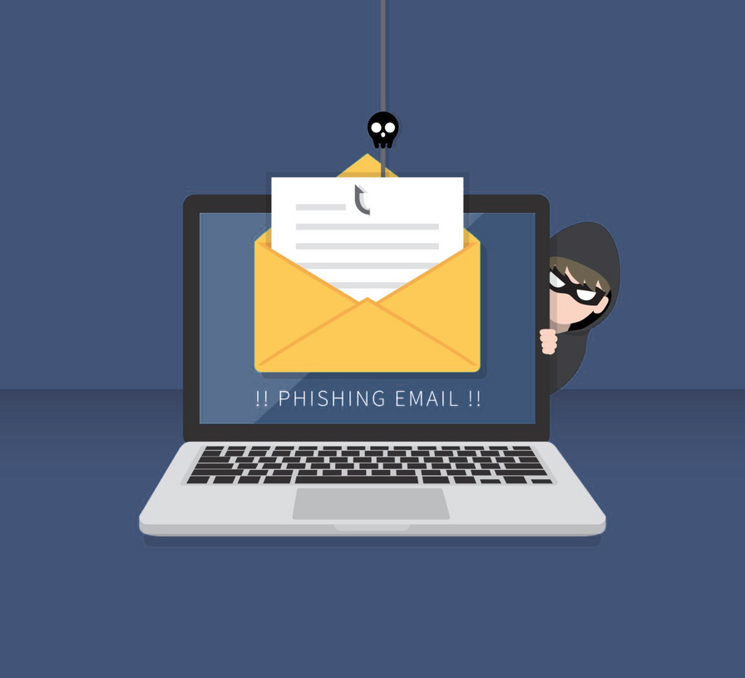
How to Recognize Phishing Emails
Look for suspicious sender addresses (e.g., info@amaz0n.com instead of info@amazon.com).
Generic greetings like “Dear Customer” instead of your name.
Urgency or threats (e.g., “Your account will be closed if you don’t act now!”).
Suspicious links or attachments – hover over links to verify the URL.
Poor grammar or spelling mistakes.

Slide 5
Inspect the URL
Check the website address carefully, as phishing sites often mimic legitimate sites with slight variations or misspellings.
Recognizing Fake Websites
Verify Security Indicators
Look for HTTPS and the padlock icon, but remember that a secure connection alone doesn’t guarantee the site is safe.
Assess Website Authenticity
Examine logos, design, and overall quality—any inconsistencies or unusual requests for personal/financial information are red flags.

Slide 6



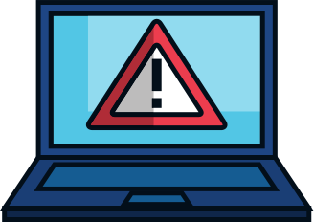
Best Practices to Avoid Phishing
Never click on suspicious links or download unknown attachments.
Use multi-factor authentication (MFA) whenever possible.
Verify requests for sensitive information via trusted channels.
Keep software and antivirus programs up to date.

Slide 7
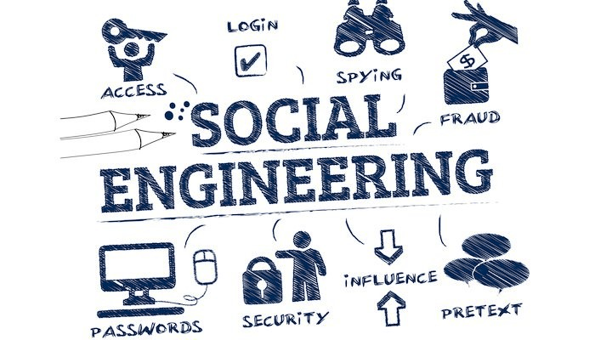
Social Engineering Tactics
Attackers exploit human psychology, not technical vulnerabilities.
Common tactics include:
Fear and urgency (“Immediate action required!”)
Curiosity (“Click to see who sent you a gift!”)
Authority impersonation (pretending to be your boss or IT support)
Reciprocity (offering rewards or incentives)

Slide 8



Email from “IT Support” asking to reset your password – link leads to fake login page.
SMS claiming you won a prize – asks for personal info.
Real-World Examples
Phishing email with an invoice attachment – malware download

Slide 9
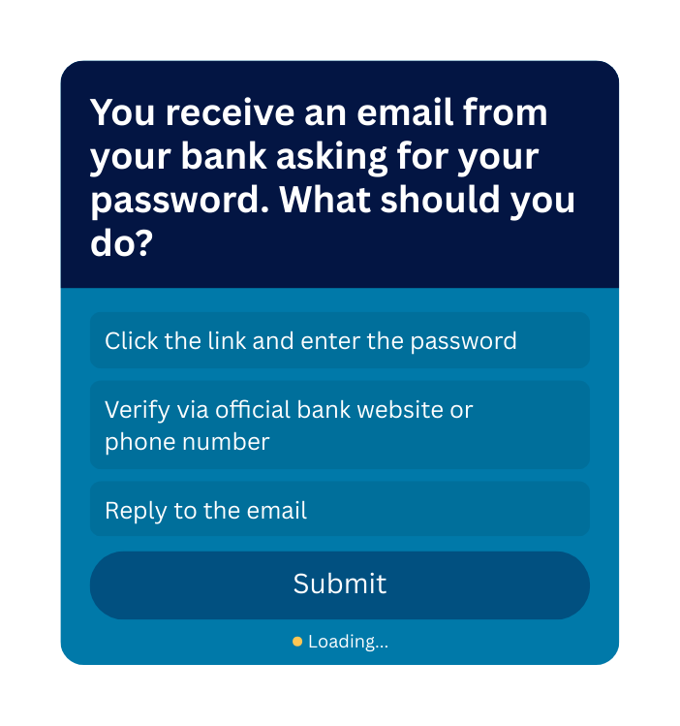
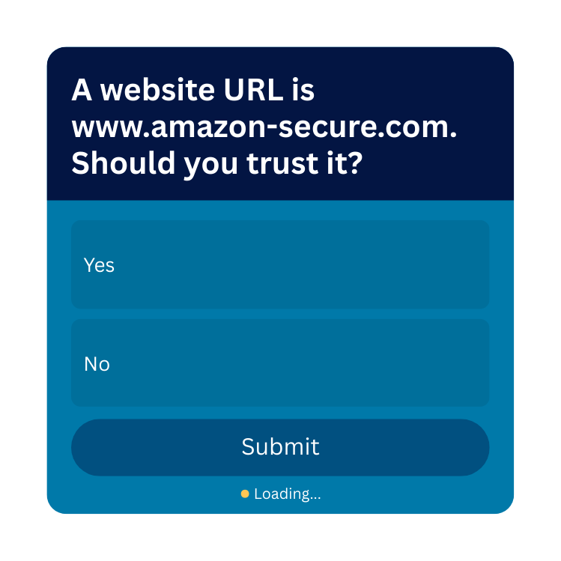
Interactive Quiz

Slide 10
Summary
Phishing is dangerous but avoidable.
Always be cautious with emails, links, and requests for sensitive information.
Use verification, MFA, and reporting to stay safe.
Remember: If it seems suspicious, don’t click it!

Slide 11
RESOURCES & REPORTING
ANTI-PHISHING TOOL LINKS: PHISHTANK, APWG
Tips & Guides: Company Security Policies, Cybersecurity Awareness Material

Slide 12
THANK YOU!

